Slide 1

CSC- 362 Computer Networks Week-1 Lecture-1& 2
Prepared by:
Mr. Attique Ur Rehman

Slide 2
Instructor Contact Details
Name: Mr. Attique Ur Rehman
Course Instructor: CSC362- Computer Networks
Credit Hours: (3+1)=4
Office Location: 2nd Floor Computer Science Faculty Office: 41-C
Email: attique.rehman@lgu.edu.pk
Visiting Hours: Wednesday (11:30 am -1:00 pm)

Slide 3
Course Material
Reference books
Many textbooks on Networking may be consulted
Research papers!
RFCs and Internet drafts
Related to TCP/IP suite and other protocols
Web resources
Tutorials, white papers, reports, etc.

Slide 4
Grading Policy
Sessional 16%
Assignment 6%
Quiz 8%
Class participation 2%
Lab 33%
Mid Term 16%
Final 35%

Slide 5
Text Book
Computer Networks: A Systems Approach by Larry L. Peterson and Bruce S. Davies.
Third Edition [2003], Morgan Kaufmann Publishers, San Mateo, California, USA
Computer Networks by Andrew S. Tanenbaum
Fifth Edition
Data Communication and Computer Networks, by Behrouz A. Forouzan
5th Edition
Data and Computer Communications by William Stallings
10th Edition
Computer Networking: A Top-Down Approach Featuring the Internet by James F. Kurose and Keith W. Ross
6th edition

Slide 6
Academic Honesty
Your work in this class must be your own
If students are found to have collaborated excessively or to have cheated (e.g. by copying or sharing answers during an assignment or examination), all involved will at a minimum receive grades of 0 for the first infraction
Further infractions will result in failure in the course

Slide 7
Expectations
What do you want (or expect) to learn from
this course ?

Slide 8
Expectations
This course IS about …
Network principles and concepts
General purpose computer networks
Internet perspective
Major components of the Internet protocol suite
Network software
Designing and building a system

Slide 9
Course Contents
Introduction and protocols architecture
Basic concepts of networking
Network topologies
Networks Requirements & Network models (Layered architecture)
Physical layer functionality
Data link layer functionality
Data Encoding/ Framing
Error Detection & Correction Protocol
Reliable Transmission (Stop wait and Sliding window)

Slide 10
Course Contents
Multiple Access
Ethernet And FDDI
Packet switching
Circuit switching and packet switching
LAN technologies
Wireless networks
MAC addressing
Networking devices

Slide 11
Course Contents
Network Layer/Internetworking
Internet protocol (IPv4 and IPv6)
Logical addressing/ IP addressing
Routing protocols
Sub-netting
CIDR
Transport Layer/ End-to-end protocols
TCP
UDP
Ports and sockets
Connection establishment

Slide 12
Course Contents
Flow and Congestion control
Application layer protocols
Latest trends in computer networks

Slide 13
Significance and Rationale of course
Networks and telecommunication is getting more and more importance
Future telecommunication networks will be more oriented toward “networks” rather than “communication”
Widespread Internet, diffused in our daily life is a ground reality; its beneficial to understand it
Its fun to play with protocols (software) and able to design exciting new type of networks

Slide 14
Introduction
A network is a set of devices (often referred to as nodes) connected by communication links. A node can be a computer, printer, or any other device capable of sending and/or receiving data generated by other nodes on the network.
The concept of connected computers for sharing resources is called Networking

Slide 15
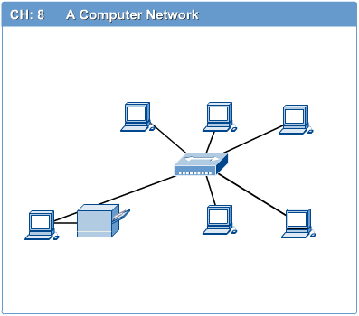
Computer Network
Computer network connects two or more autonomous computers.
The computers can be geographically located anywhere.

Slide 16
Applications of Networks
Resource Sharing
Hardware (computing resources, disks, printers)
Software (application software)
Information Sharing
Easy accessibility from anywhere (files, databases)
Search Capability (WWW)
Communication
Email
Message broadcast
Remote computing
Distributed processing (GRID Computing)

Slide 17
Applications – Users’ Contact with the Network
Most people know the Internet through its applications
Web, email, streaming audio and video, chat, …
Applications present an intuitively simple interface
Textual and graphical objects
Simple “clicks” to maneuver the application
However, users are not aware of what happens in the network with their simple “clicks” !!!

Slide 18
Applications – Consumers of Networks
On a simple click, several messages may be exchanged over the Internet
In a web browser, 17 messages may be exchanged
up to six messages to translate the server name
three messages to set up a TCP connection
four messages to send HTTP “get” request + response
four messages to tear down the TCP connection
Moreover, millions of messages are exchanged each day by Internet nodes to make their presence and services known

Slide 19
Applications – the Driving Force
Streaming audio and video is an emerging application
Source generates and sends the video stream in messages across the Internet
Video-on-demand: reads a preexisting movie
One-way data transfer
Videoconferencing: interactive session
Very tight timing constraints
Diversity of applications that can be built on top of the Internet hint at the complexity of the Internet design

Slide 20
Network Overview
What must a network provide ?
connectivity
cost-effective sharing (information &resources)
functionality
Performance
Reliability
Security
How are networks designed and built ?
layering
protocols
standards

Slide 21
Perspective
For network user
connectivity: for services required; error free delivery within acceptable time limits
For network designer
efficiency: cost-effective design, fair allocation and efficient use of resources
For network operator
maintenance: easy to administer, fault localization & isolation, usage accounting

Slide 22
Network Components
Physical Media
Interconnecting Devices
Computers
Networking Software
Applications

Slide 23
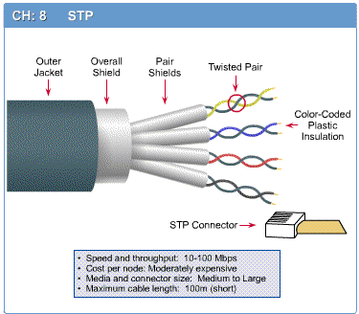
Networking Media
Networking media can be defined simply as the means by which signals (data) are sent from one computer to another (either by cable or wireless means).

Slide 24
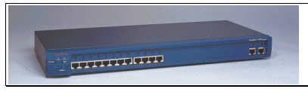
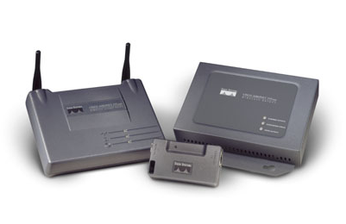
Networking Devices
HUB, Switches, Routers,
Wireless Access Points,
Modems etc.

Slide 25

Applications
E-mail
Searchable Data (Web Sites)
E-Commerce
News Groups
Internet Telephony (VoIP)
Video Conferencing
Chat Groups
Instant Messengers
Internet Radio

Slide 26
Types of connection
A network is two or more devices connected through link
A link is a communications pathway that transfers data from one device to another
There are two types of connection
Point to point
Provide a dedicated link between two devices
Multipoint
More than two devices share single link

Slide 27
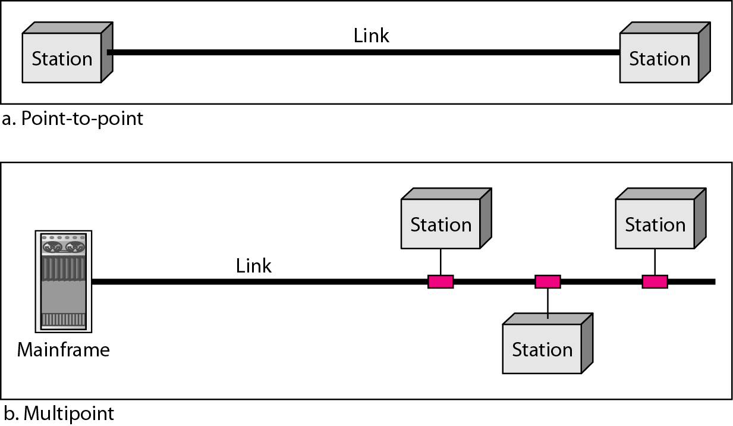
Types of connection

Slide 28
Classification of networks
Depending upon size networks are divided into two major categories
Local Area Network (LAN)
Area less than 2 miles
Wide Area Network (WAN)
World wide
Metropolitan Area Network (MAN)
Spans tens of miles

Slide 29
Most Elementary Network
Two Computers (Stations) communicating over a cable

Slide 30
Local Area Network (LAN)
A local area network (LAN) is a number of computers connected each other by cable in a single location ,usually a single floor of a building or all the computers in a small company.
Characteristics:
Scope of LAN is small --- building or cluster of buildings
LAN is owned by the same organization that owns the attached devices
Data rates of LAN are much higher --- 100 or 1000Mbps
Purpose
To allow resources to be shared between personal computers
Example
Engineering workstation environment
Accounting PCs

Slide 31
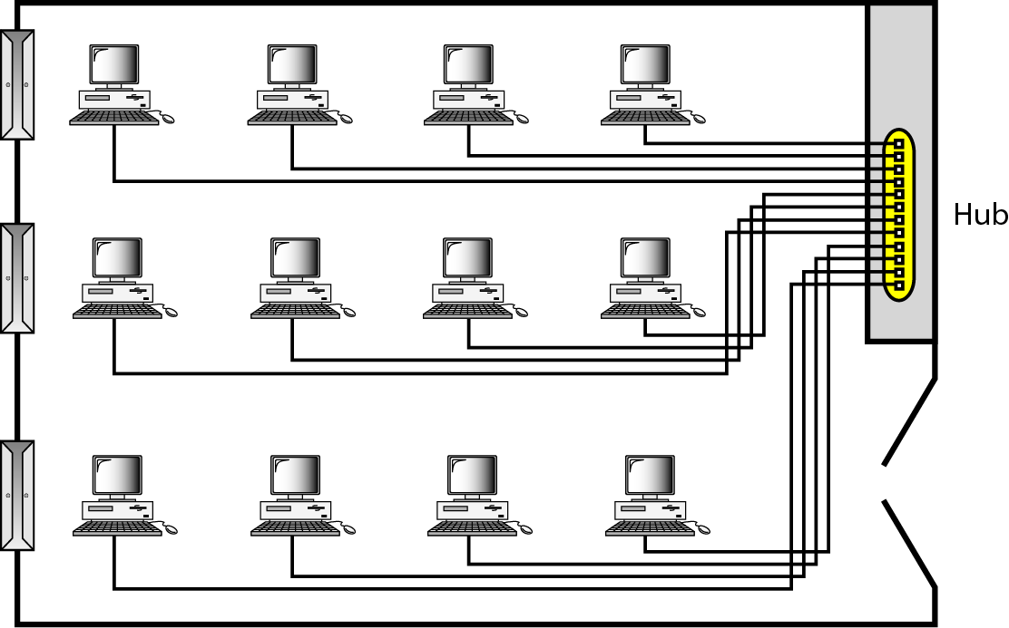
Local Area Network (LAN)

Slide 32
Wide Area Networks (WANs)
Wide area networks (WANs) are the set of connecting links
between local area networks.
Network spread Geographically (country or Globe) is called
Wide area networks (WANs)
Characteristics:
Cover large geographical area
Require crossing of public right of ways
Relay at least in part on circuits provided by a common
carrier
Consists of number of interconnected switching nodes
Example
ATM network

Slide 33
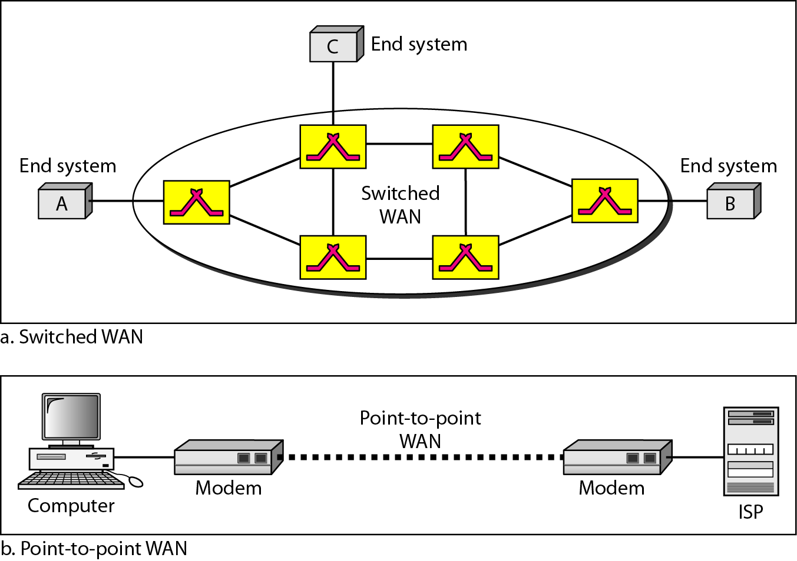
Wide Area Networks (WANs)

Slide 34
Metropolitan Area Network (MAN)
Network in a City is call MAN (Metropolitan Area Network)
Examples
Cable TV networks
Telephone company networks that provide high speed DSL line

Slide 35
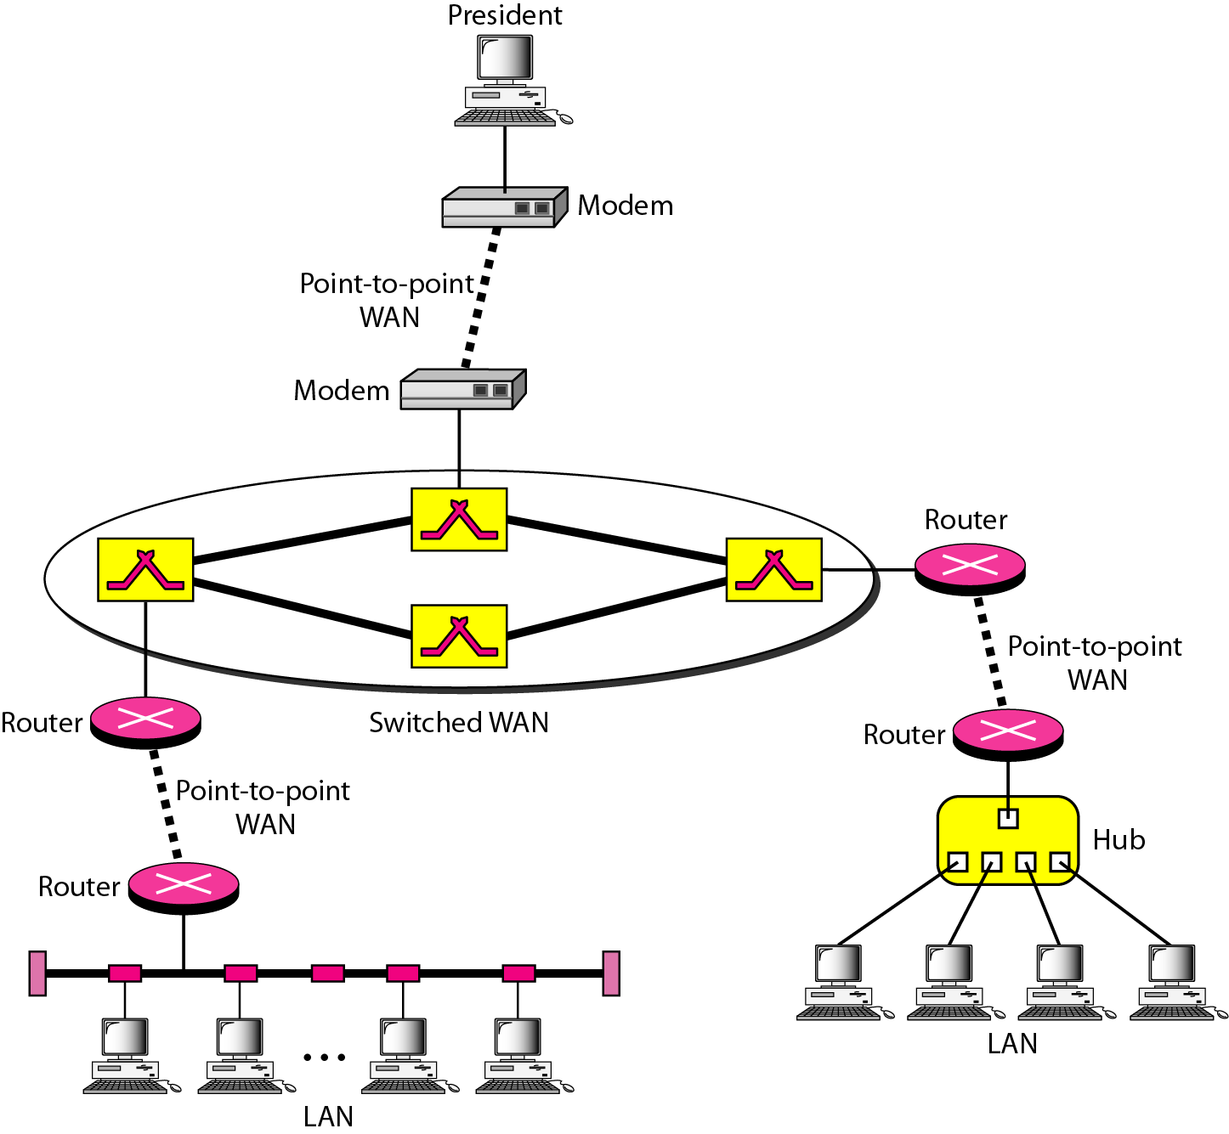
Interconnection of Networks: Internetwork

Slide 36
The Internet
The Internet has revolutionized many aspects of our daily lives. It has affected the way we do business as well as the way we spend our leisure time.
The Internet is a communication system that has brought a wealth of information to our fingertips and organized it for our use.

Slide 37
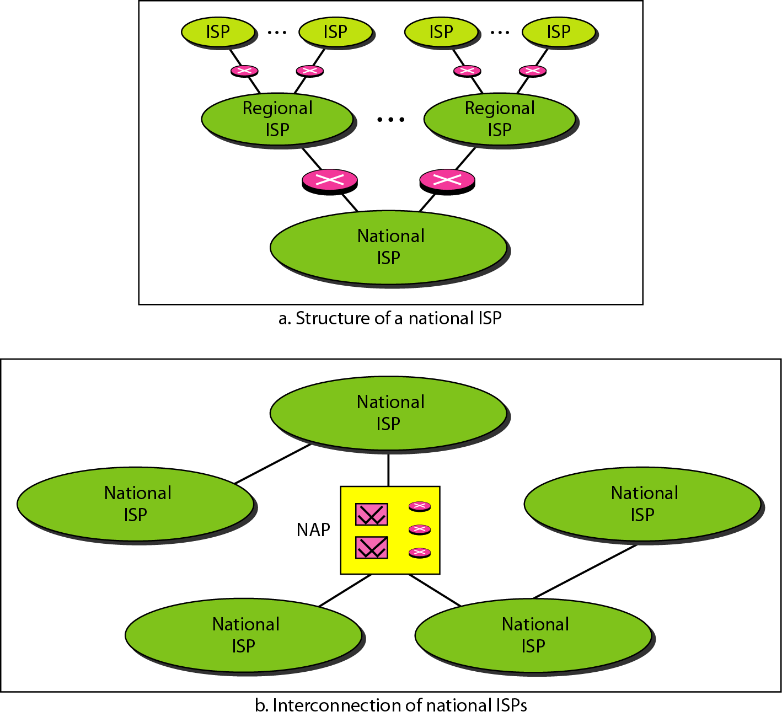
The Internet

Slide 38
PROTOCOLS AND STANDARDS
Protocol: which is synonymous with rule. The key elements of protocol are
Syntax
Semantics
Timing
Standards: which are agreed-upon rules.
Standards organizations:
International organization for standardization (ISO)
International telecommunication union-Telecommunication standards sectors (ITU-T)
Institute of electrical and electronic engineering (IEEE)

Slide 39
Network Topology
The way in which the connection is made is called the topology of the network.
Network Topology specifically refers to the physical lay out of network.
The network topology defines the way in which computers, printers, and other devices are connected.
A network topology describes the layout of the wire and devices as well as the paths used by data transmissions.

Slide 40
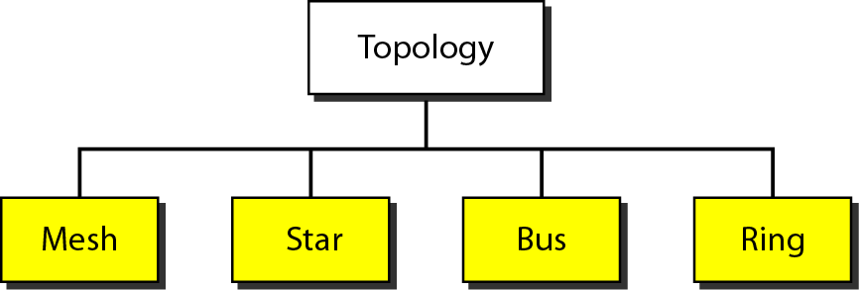
Network Topologies

Slide 41
Network Topologies
Bus Topology
Star Topology
Ring Topology
Mesh Topology

Slide 42
Bus Topology
Computers are connected through a cable with no active electronics to amplify the signal or pass it along from computer to computer.
It is passive topology
The bus topology is often used when a network installation is small, simple, or temporary

Slide 43
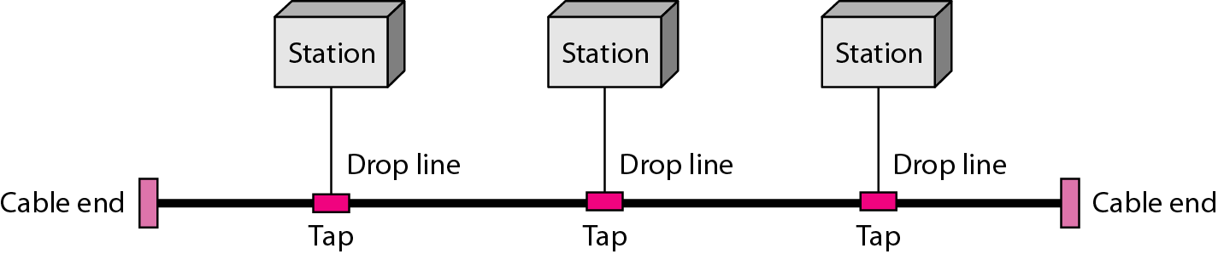
Bus Topology

Slide 44
Advantages Of Bus Topology
Simple, reliable, small and easy to use
Less expensive due to less cable requirements
Easy to extend with the help of BNC and Repeater

Slide 45
Disadvantages of Bus Topology
Heavy Traffic can slow a Bus.
Each Barrel connector weak the electrical signal and to many may prevent the signal form being correctly received along a Bus.
It is difficult to troubleshoot.

Slide 46
Star Topology
In a Star Topology all the cables run from the computers to a central location , where they all are connected by a device usually called Hub.
The star topology is the most commonly used architecture in Ethernet LANs.
When installed, the star topology resembles spokes in a bicycle wheel.
Larger networks use the extended star topology also called tree topology.
When used with network devices that filter frames or packets, like bridges, switches, and routers, this topology significantly reduces the traffic on the wires by sending packets only to the wires of the destination host.

Slide 47
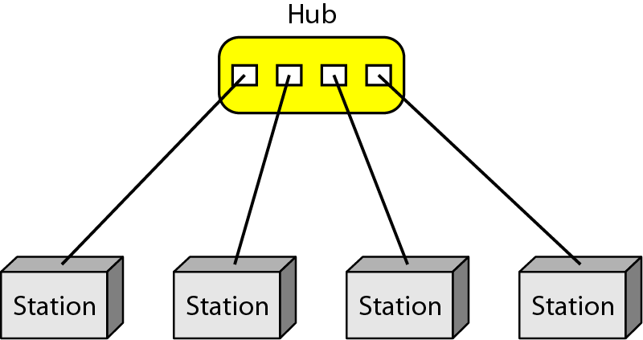
Star Topology

Slide 48
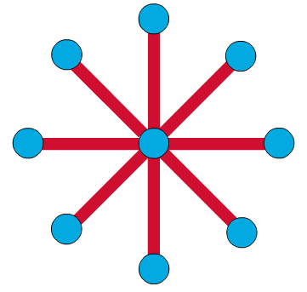
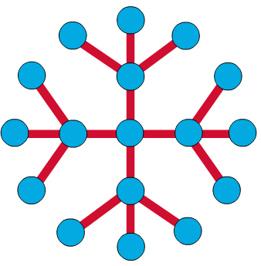
Star and Tree Topology

Slide 49
Advantages Of Star Topology
It is easy to modify and add new computers to Star networks with out disturbing rest of the networks
The center of star networks is a good place to diagnose network faults.
Signal computer failures do not necessary bring down the whole Star networks

Slide 50
Disadvantages Of Star Topology
If the central Hub fails, the whole network fails to operate
Many star networks require a device at the central point to rebroadcast switch network traffic
It cost more to cable

Slide 51
Ring Topology
In a Ring Topology, each computer is connected to the next , with the last one connected to the firs computer
A frame travels around the ring, stopping at each node. If a node wants to transmit data, it adds the data as well as the destination address to the frame.
The frame then continues around the ring until it finds the destination node, which takes the data out of the frame.

Slide 52
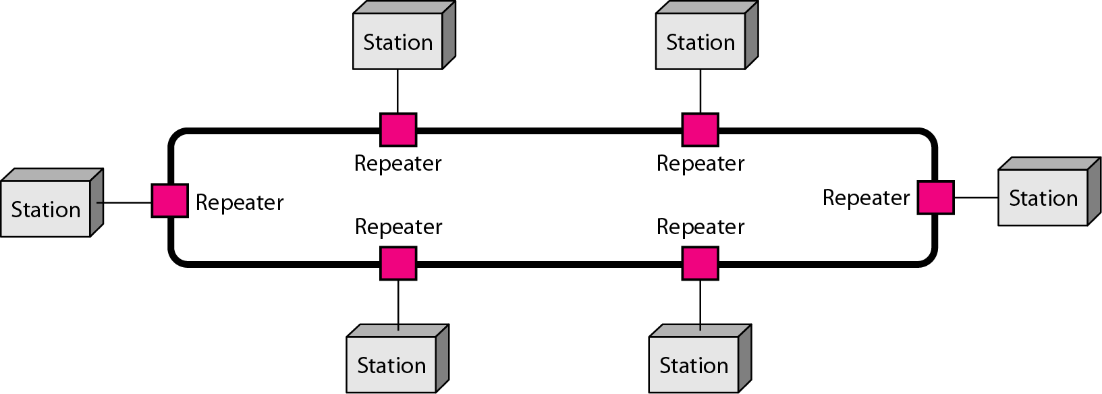
Ring Topology

Slide 53
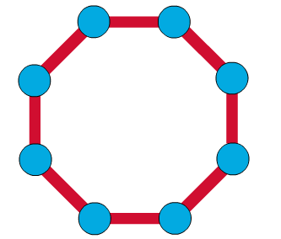
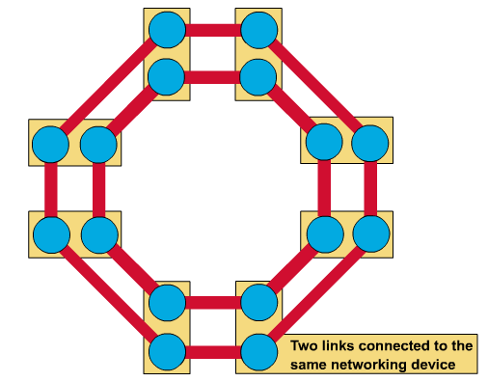
Single and Dual Ring
Single ring – All the devices on the network share a single cable
Dual ring – The dual ring topology allows data to be sent in both directions.

Slide 54
Advantages Of Ring Topology
No one computer can monopolize the network
The fair sharing of the network allows the network to degreed gracefully as more user are added

Slide 55
Disadvantages Of Ring Topology
Failure of one computer on the Ring can affect the whole network
It is difficult to trouble shoot a Ring network
Adding or removing computer disrupts the networks

Slide 56
Mesh Topology
The mesh topology having redundant links between devices. A true mesh configuration has a link between each device in the network
It is used in WANs to interconnect LANs for mission critical networks like those used by banks and financial institutions

Slide 57
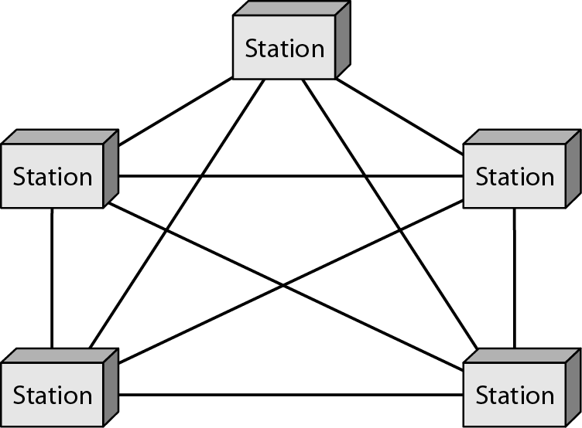
Mesh Topology

Slide 58
Advantages Of Mesh Topology
The Mesh Topology is fault tolerance
Include guaranteed communication channel capacity
Easy to trouble shoot

Slide 59
Disadvantages Of Mesh Topology
Difficult to install and configure
Expensive to maintain

Slide 60
Clients, Servers, and Peers
There are three roles for computers in local area networks (LAN)
- Clients, Which use but do not provide network resources
- Peers, Which both use and provide network resources
- Servers, Which provide network resources

Slide 61
Networks Division
Base on the roles of computers connected to them, networks are divided into three types
-Server-based (client-server): containing clients and the servers that support them.
-Peer (peer to peer): which have no servers and use the network to share resources among independent peers
-Hybrid network: which is client –server network that also has peer sharing resources and use the

Slide 62
Server-Based Networks
Are defined by the presence of servers on the network that provide security and administration of the network.
Divide processing tasks between client and servers
Clients request services, such as file storage and printing, and servers deliver them
Server computers are more powerful than client

Slide 63
Advantages of Server-Based Networks
Strong central security
Central file storage, which allow all users to work from the same set of data and provides easy backup to critical data
Ability of servers to pool available hard ware, lowering overall cost
Ability to share expensive equipment, such as laser printers

Slide 64
Advantages of Server-Based Networks
Optimized dedicated servers, which are faster than peers at sharing network resources
Less intrusive security, since a single password allows access to all shared resources on the network
Freeing of users from the task of managing the sharing of resources
Easy manageability of a large number of users
Central organization, which keeps data from getting lost among computers

Slide 65
Disadvantages of Server-Based Networks
Expensive dedicated hardware
Expensive network operating system software and client licenses
A dedicated network administrator

Slide 66
Peer Networks
Are defined by a lack of central control over the network. There are no servers in peer networks; users simply share disk space and resources
Are organized into workgroups with little security control
No central login process
Not optimized to share resources

Slide 67
Advantages of Peer Networks
No extra investment in server hardware or software is required
Easy setup
No network administrator required
Ability of users to control resources sharing
No reliance on other computers for their operation
Lower cost for small networks

Slide 68
Disadvantages of Peer Networks
Additional load on computers because of resources sharing
Inability of peers to handle as many network connection as servers
Lack of central organization, which make data hard to find
No central point of storage for file archiving
Requirement that users administer their own computer
Weak and intrusive security
Lack of central management, which makes large peer networks hard to work with

Slide 69
Hybrid Networks
Have all three types of computers operating on them and generally have active domains and work groups
Most sharing resources are located on server , network user still have access to any resources being shared by peers in workgroup
User do not have to log on to the domain controller to access workgroup resources

Slide 70
Advantages of Hybrid Networks
The advantages of server-based networking
Many of the advantages of peer-based networking
Ability of users and network administrators to control security based on the importance of the shared resource

Slide 71
Disadvantages of Hybrid Networks
Hybrid computing share the disadvantages of server-based networking

Slide 72
Peer Security vs. Server Security
Peer to networks are usually less secure than a server base networks, because this commonly use share – level security, while server based networks commonly use file - level or access permission security.

